Slide 1
Lecture 7
Dr. Lauren Chenarides
October 7, 2025

Slide 2
Rule No. 1 is never lose money. Rule No. 2 is never forget Rule No. 1. -Warren Buffett (Net worth = $149.4 Billion USD)

Slide 3

Lecture 7: Entrepreneurial Finance
Textbook Reading (Quiz Basis)
Chapter 8. Sources of Capital for Entrepreneurs
Lecture Agenda
1. Review sources of capital
2. Investor activity

Slide 4
Chapter 8 Objectives
8.1 Explain the advantages and disadvantages of bootstrapping.
8.2 Differentiate between debt and equity as methods of financing.
8.3 Discuss commercial loans and social lending as sources of capital.
8.4 Explain initial public offerings (IPOs) as a source of capital.
8.5 Describe the special purpose acquisition companies (SPACs).
8.6 Discuss private placements as an opportunity for equity capital.
8.7 Describe the rise of crowdfunding as an increasingly potential source of funding.
8.8 Explain the market for venture capital.
8.9 Describe venture capitalists’ evaluation criteria for new ventures.
8.10 Explain the importance of evaluating venture capitalists for a proper selection.
8.11 Describe the existing informal risk-capital market (“angel capital”).

Slide 5
Sources of Capital
Entrepreneurs must match their funding strategy to their stage of growth, risk tolerance, and control preferences.
Sources
Commercial loans
Public offerings
Private placement
Convertible debentures
Venture capital
Informal risk capital
Can be combination of sources
Can be debt or equity

Slide 6
Sources of Capital
Bootstrapping
Debt Financing
Equity Financing
Crowdfunding
Venture Capital
Angel Financing

Slide 7
Connecting Case Studies to Sources of Capital
Stirring the Lobster Pot
Angel investment and local equity financing
Crickets, Chitin, and Green Ink
Bootstrapping and trade credit
Culture of Love
Peer-to-peer and social lending
Dinr
Bootstrapping, crowdfunding, and early venture capital

Slide 8
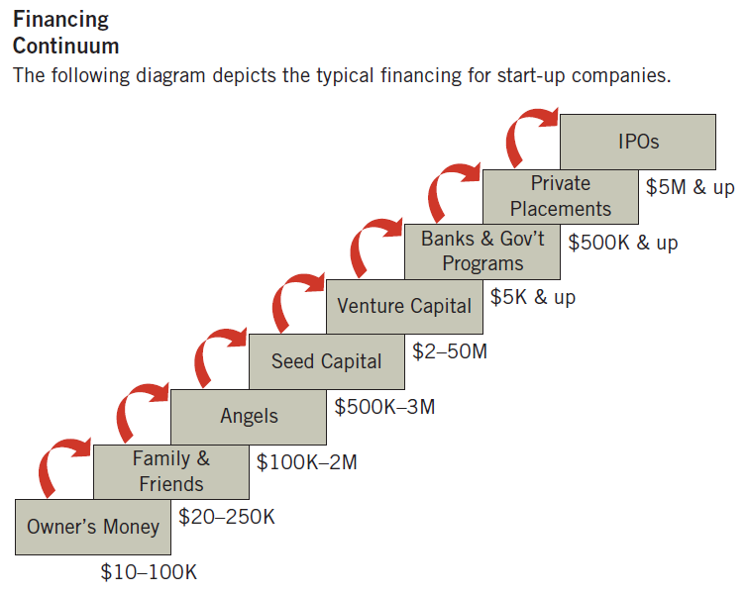
Who Is Funding Entrepreneurial Start-Up Companies?
Personal and community funding (bootstrapping, social lending, angels) to institutional and public markets (VC, private placements, IPOs)
Source: “Successful Angel Investing,” Indiana Venture Center, March 2008.

Slide 9
Choosing a Source of Capital
Stage / Condition | Capital Need | Control Preference | Risk Tolerance | Investor Expectation | Recommended Sources | Notes / Tradeoffs
Ideation / Early Stage | <$50K | Maintain full control | High personal risk | None or informal | Bootstrapping, Friends & Family, Grants | Fast access; may strain personal finances or relationships
Prototype / Start-Up | $50K–$250K | Moderate control sharing | Moderate | Moderate guidance | Angel Investors, Crowdfunding (equity or reward) | Angels bring mentorship; crowdfunding provides visibility
Growth / Expansion | $250K–$5M | Willing to share equity | Moderate to high | Professional oversight | Venture Capital, Private Placements, SPACs | High potential for scale; reduced control; formal governance
Mature / Scaling | $5M+ | Public accountability acceptable | Low | High transparency | Public Offering (IPO) | Expensive and heavily regulated; strong liquidity and capital access
Cash Flow Support (any stage) | Varies | Full control desired | Low | Repayment required | Commercial Loans, Trade Credit, Accounts Receivable Financing, Factoring | No equity dilution but increases financial obligations
Social / Mission-Driven Ventures | <$500K | Collaborative | Moderate | Social impact focus | Crowdfunding, Program-Related Investments (PRIs) | Emphasis on community engagement over profit

Slide 10
Sources of Capital
Bootstrapping
Debt Financing
Equity Financing
Common Stock
IPOs
Crowdfunding
Venture Capital
Angel Financing
Commercial Loans
Peer-to-Peer Lending
Trade Credit
Accounts Receivable Financing
Factoring
Private Placements

Slide 11
Sources of Capital
Bootstrapping
Debt Financing
Commercial Loans
Peer-to-Peer Lending
Trade Credit
Accounts Receivable Financing
Factoring
Equity Financing
Common Stock
IPOs
Private Placements
Crowdfunding
Venture Capital
Angel Financing

Slide 12
Bootstrapping
Definition: Bootstrapping is using personal finances or the operating revenues of the new company to build a new company.
Why bootstrap?
Unwillingness of equity investors
Desire for autonomy
Lack of knowledge of other options

Slide 13
Advantages and Disadvantages of Bootstrapping
Advantages
Cost: it is inexpensive
Control: no external investors
Concentration: can focus on business
Disadvantages
Cash: may need more funds
Equity: if more than one founder
Risk: higher due to lack of funds
Stress: due to money from friends and family

Slide 14
Sources of Capital
Bootstrapping
Debt Financing
Commercial Loans
Peer-to-Peer Lending
Trade Credit
Accounts Receivable Financing
Factoring
Equity Financing
Common Stock
IPOs
Private Placements
Crowdfunding
Venture Capital
Angel Financing

Slide 15
Debt Financing
Debt Financing
Secured financing of a new venture that involves a payback of the funds plus a fee (interest) for the use of the money.

Slide 16
Commercial Loans
Commercial Banks
Make one- to five-year, intermediate-term loans secured by collateral (receivables, inventories, or other assets).
Questions in securing a loan:
What do you plan to do with the money?
How much do you need?
When do you need it?
How long will you need it?
How will you repay the loan?

Slide 17
Peer-to-Peer Lending (P2P)
Definition: Peer-to-peer (P2P) lending is money between unrelated individuals, or “peers,” without going through a bank.
Are often Internet-based sites that pool money from investors willing to lend capital at agreed-upon rates.
Fees are applied for brokering and servicing loans.
Possible Dangers
Low funding success rate
Business plan disclosure to the public
No ongoing counseling relationship
Potential tax liability
Uncertain regulatory environment

Slide 18
Other Debt-Financing Sources
Trade Credit
Credit given by suppliers who sell goods on account.
Accounts Receivable Financing
Short-term financing that involves either the pledge of receivables as collateral for a loan or the sale of receivables at a discounted value (factoring).
Factoring
Sale of accounts receivable at discounted values.
Finance Companies
Asset-based lenders that lend money against assets such as receivables, inventory, and equipment.

Slide 19
Common Debt Sources
 | Business Type Financed |  |  | Financing Term
Source | Start-Up Firm | Existing Firm | Short Term | Intermediate Term | Long Term
Trade credit | Yes | Yes | Yes | No | No
Commercial banks | Sometimes, but only if strong capital or collateral exists | Yes | Frequently | Sometimes | Seldom
Peer-to-peer (P2P) | Yes | Yes | Yes | Sometimes | No
Finance companies | Seldom | Yes | Most frequent | Yes | Seldom
Factors | Seldom | Yes | Most frequent | Seldom | No
Leasing companies | Seldom | Yes | No | Most frequent | Occasionally
Mutual savings banks and savings and loan associations | Seldom | Real estate ventures only | No | No | Real estate ventures only
Insurance companies | Rarely | Yes | No | No | Yes

Slide 20
Debt Financing
Advantages
No relinquishment of ownership is required.
More borrowing allows for potentially greater return on equity.
Low interest rates reduce the opportunity cost of borrowing.
Disadvantages
Regular (monthly) interest payments are required.
Cash-flow problems can intensify because of payback responsibilities.
Heavy use of debt can inhibit growth and development.

Slide 21
Sources of Capital
Bootstrapping
Debt Financing
Commercial Loans
Peer-to-Peer Lending
Trade Credit
Accounts Receivable Financing
Factoring
Equity Financing
Common Stock
IPOs
Private Placements
Crowdfunding
Venture Capital
Angel Financing

Slide 22
Equity Financing
Equity Financing
Involves the sale (exchange) of some of the ownership interest in the venture in return for an unsecured investment in the firm.

Slide 23
Equity Financing (1 of 2)
Money invested in the venture with no legal obligation for entrepreneurs to repay the principal amount or pay interest on it.
Requires sharing the ownership and profits with the funding source.
Much safer option for new ventures than debt financing.
Owner must be willing to give up part of the ownership in return for funding.

Slide 24
Equity Financing (2 of 2)
Gives investors a share of the ownership:
Loan with warrants provide the investor with the right to buy stock at a fixed price at some future date.
Convertible debentures are unsecured loans that can be converted into stock.
Preferred stock is equity that gives investors a preferred place among the creditors in the event the venture is dissolved.
Common stock is the most basic form of ownership; stock issues often are sold through public or private offerings.

Slide 25
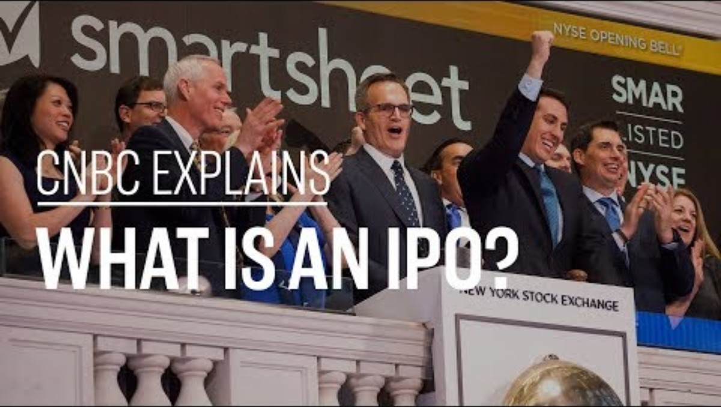
Initial Public Offerings (1 of 2)
“Going public” refers to a corporation’s raising capital through the sale of its securities on the stock markets.
Initial public offerings (IPOs): New issues of common stock.

Slide 26
Initial Public Offerings (2 of 2)
“Going public” refers to a corporation’s raising capital through the sale of its securities on the stock markets.
Initial public offerings (IPOs): New issues of common stock.
Advantages
Size of capital amount
Liquidity
Value
Image
Disadvantages
Costs
Disclosure
Requirements
Shareholder pressure

Slide 27
Special Purpose Acquisition Companies
Special purpose acquisition company (SPAC)
Formed to raise capital through IPO to merge with an existing company.
Growing industry with $80 billion raised in 2020 and $96 billion in 2021.
Raise IPO money, then have two years to complete acquisition or merger, or liquidate and return money.
IPO involves high cost, detailed disclosure, paperwork requirements, shareholder pressure for earnings.

Slide 28
The Story of Corteva’s IPO
Corteva Agriscience began as the agriculture division of DowDuPont, itself a 2017 merger between Dow Chemical and DuPont.
The merger was designed as a temporary structure—a way to combine and then reorganize three distinct businesses:
Dow (materials science)
DuPont (specialty products)
Corteva (agriculture)
The idea was to leverage short-term synergies (e.g., cost savings, scale) and then split into three independent, publicly traded companies, each focused on its core industry.

Slide 29
Formation and IPO
June 1, 2019: Corteva officially spun off from DowDuPont and began trading on the New York Stock Exchange under the ticker “CTVA.”
The separation made Corteva a standalone agriculture company, combining DuPont Pioneer (seeds and traits), DuPont Crop Protection, and Dow AgroSciences.
At the time of the spinoff, Corteva had about 21,000 employees, operations in 140 countries, and roughly $14 billion in annual sales.

Slide 30
Structure of the Spinoff
The transaction was structured as a distribution of Corteva stock to existing DowDuPont shareholders, meaning they received shares in Corteva proportional to their DowDuPont holdings.
This wasn’t a traditional IPO where new shares are sold to raise capital. Instead, it was a tax-free spinoff, though Corteva became a publicly listed company through that process.
Following the separation:
Dow Inc. focused on plastics and chemicals.
DuPont de Nemours, Inc. focused on specialty materials and electronics.
Corteva Agriscience focused on agriculture—seeds, crop protection, and digital solutions.

Slide 31
Rationale
The logic behind the separation was that each company could:
Better focus on its own strategy and innovation pipeline.
Improve operational efficiency and capital allocation.
Attract investors who preferred a pure-play company (for example, investors focused only on agriculture rather than diversified chemicals).
Corteva positioned itself as a “pure-play agriculture leader”, competing with firms like Bayer Crop Science (after Bayer acquired Monsanto), BASF, and Syngenta.

Slide 32
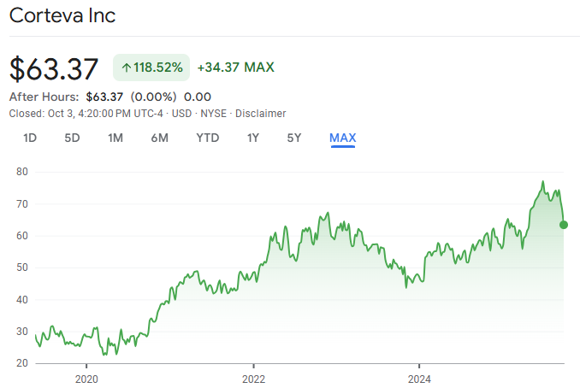
Post-Spinoff Performance
Corteva has emphasized seed genetics (Pioneer brand), crop protection chemistry, and biological products, alongside digital agriculture platforms to help farmers make data-driven decisions.
The company faced early headwinds in commodity markets and integration costs but has since strengthened its margins through innovation and cost discipline.

Slide 33
Lessons Learned from Corteva
Corteva’s spinoff is a modern example of how corporate restructuring and public offerings can unlock shareholder value by allowing focused, standalone companies to pursue growth in specialized sectors.
It demonstrates the strategic use of equity markets to reconfigure large conglomerates—an alternative to traditional IPOs or mergers.
It also illustrates how public listings can be used not only to raise capital but to redefine corporate identity in response to market and investor expectations.

Slide 34
Private Placements
Another method of raising capital is through the private placement of securities (e.g., stocks or bonds).
The Securities and Exchange Commission (SEC) provides a Regulation D, which allows smaller firms to sell stock through Direct Public Offerings (DPO)
Regulations dictate reports and statements required when selling stock to private parties—friends, employees, customers, relatives, and professionals.

Slide 35
Sources of Capital
Bootstrapping
Debt Financing
Commercial Loans
Peer-to-Peer Lending
Trade Credit
Accounts Receivable Financing
Factoring
Equity Financing
Common Stock
IPOs
Private Placements
Crowdfunding
Venture Capital
Angel Financing

Slide 36
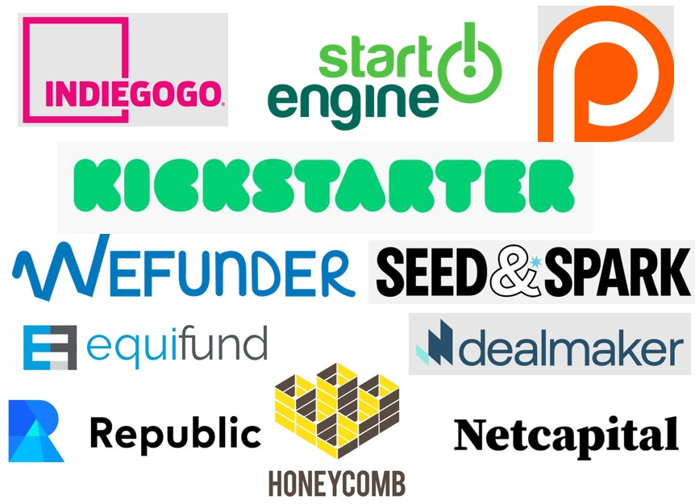
Crowdfunding (1 of 3)
Definition: Crowdfunding seeks funding for ventures by raising monetary contributions from a large number of people, usually via the Internet.
Three Principal Parts:
The entrepreneur proposes the idea and/or venture to be funded.
The individual or groups who support the idea.
A moderating organization (the “platform”) that brings the parties together to launch the idea.

Slide 37
Crowdfunding (2 of 3)
Two Distinct Forms:
Rewards Crowdfunding—The entrepreneur seeks a target amount of funding to launch a business concept without incurring debt or sacrificing equity and, in return for the donation, the entrepreneur provides some type of gift or incentive.
Equity Crowdfunding—The entrepreneur shares equity in the venture, usually in its early stages, in exchange for the money pledged.

Slide 38
Crowdfunding (3 of 3)
Potential concerns:
Reputation
Intellectual property (IP) protection
Donor dilution
Investor management
Public fear
Benefits:
Funding
Profile
Marketing
Engagement
Feedback

Slide 39
Value of Crowdfunding
Crowdfunding is dispersed geographically and focused on leisure, retail, and consumer products.
New legislation allows up to $50 million in crowdfunding, up from $1 million.

Slide 40
Sources of Capital
Bootstrapping
Debt Financing
Commercial Loans
Peer-to-Peer Lending
Trade Credit
Accounts Receivable Financing
Factoring
Equity Financing
Common Stock
IPOs
Private Placements
Crowdfunding
Venture Capital
Angel Financing

Slide 41
The Venture Capital Market
Definition: Venture Capitalists are valuable and powerful sources of equity funding for new ventures.
They provide:
Capital for start-ups and expansion
Market research and strategy
Management-consulting, audits, and evaluation
Contacts—customers, suppliers, and businesspeople
Assistance in negotiating technical agreements
Help in establishing management and accounting controls
Help in employee recruitment and employee agreements
Help in risk management and with insurance programs
Counseling and guidance in complying with government regulations

Slide 42
Recent Developments
After decline in 2008, in 2021, venture capital invested about $330 billion in the United States, largely in the Internet, health care, telecommunications, and software.
Such investments dropped in 2022 and 2023 due to inflation and over-valuations in earlier years.

Slide 43
VC Funding Increasing in Early-Stage Startups
Becoming more likely to invest in early-stage businesses:
More ease and efficiencies to launch a venture
Increase in incubators and accelerators
Lower infrastructure costs with cloud-based computing
Shorter product cycles
Can now sell to global consumers
Equity crowdfunding
College graduates more sophisticated with technology

Slide 44
Venture Capitalists’ Objectives
Focused on return on investment.
Weight risk and potential return
Measure product/service and the management
Return expectations vary based on market potential, management’s investment in company.
Annual goal of 20 to 30 percent is common.

Slide 45
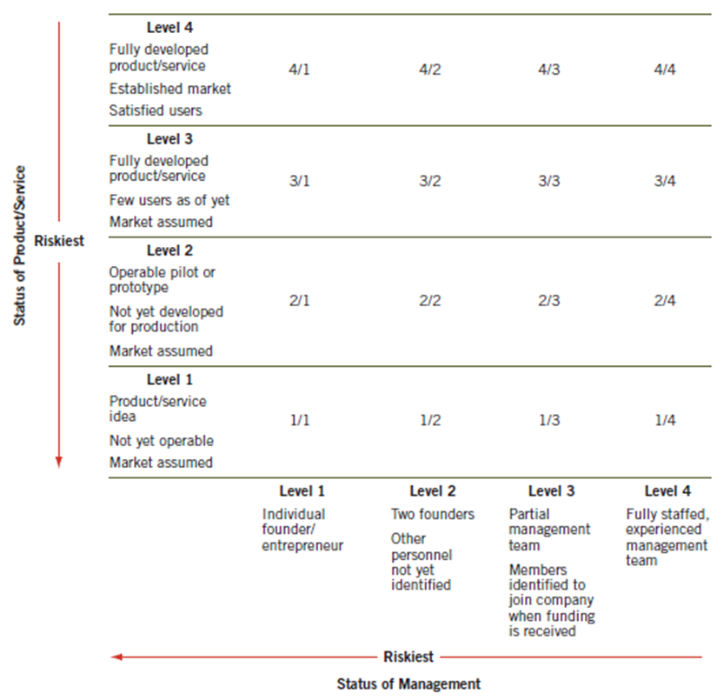
Venture Capitalist System of Evaluating Product/Service and Management
Source: Stanley Rich and David Gumpert, Business Plans That Win $$$ (New York, NY: Harper & Row, 1985), 169.

Slide 46
Returns on Investment Typically Sought by Venture Capitalists
Stage of Business | Expected Annual Return on Investment | Expected Increase on Initial Investment
Start-up business (idea stage) | 60% + | 10 to 15 × investment
First-stage financing (new business) | 40% to 60% | 6 to 12 × investment
Second-stage financing (development stage) | 30% to 50% | 4 to 8 × investment
Third-stage financing (expansion stage) | 25% to 40% | 3 to 6 × investment
Turnaround situation | 50% + | 8 to 15 × investment
Source: Adapted from W. Keith Schilit, “How to Obtain Venture Capital,” Business Horizons (May/June 1987): 78. Copyright © 1987 by the Foundation for the School of Business at Indiana University.

Slide 47
Criteria for Evaluating New-Venture Proposals (1 of 3)
Factors that are used in the evaluation of new ventures:
Timing of entry
Key success factor stability
Educational capability
Lead time
Competitive rivalry
Entry wedge imitation
Scope
Industry-related competence

Slide 48
Criteria for Evaluating New-Venture Proposals (2 of 3)
Major categories of venture capitalist screening criteria:
Entrepreneur’s personality
Entrepreneur’s experience
Product or service characteristics
Market characteristics
Financial considerations
Nature of the venture team

Slide 49
Criteria for Evaluating New-Venture Proposals (3 of 3)
Success acquiring funding related to:
Entrepreneur (education, experience, age)
Enterprise (stage, industry type, location)
Request (amount, business plan, capital source)
Source of advice (technology, business plan, funding)
Evaluating the business plan:
Proposal size
Financial projections
Investment recovery
Competitive advantage
Company management

Slide 50
Factors in Venture Capitalists’ Evaluation Process (1 of 2)
Attribute | Level | Definition
Timing of entry | Pioneer | Enters a new industry first
 | Late follower | Enters an industry late in the industry’s stage of development
Key success factor stability | High | Requirements necessary for success will not change radically during industry development
 | Low | Requirements necessary for success will change radically during industry development
Educational capability | High | Considerable resources and skills available to overcome market ignorance through education
 | Low | Few resources or skills available to overcome market ignorance through education
Lead time | Long | An extended period of monopoly for the first entrant prior to competitors entering the industry
 | Short | A minimal period of monopoly for the first entrant prior to competitors entering this industry
Source: Dean A. Shepherd, “Venture Capitalists’ Introspection: A Comparison of ‘In Use’ and ‘Espoused’ Decision Policies,” Journal of Small Business Management (April 1999): 76–87; and “Venture Capitalists’ Assessment of New Venture Survival,” Management Science (May 1999): 621–32. Reprinted by permission. Copyright © 1999, the Institute for Operation Research and the Management Sciences (INFORMS), 7240 Parkway Drive, Suite 310, Hanover MD 21076 USA.

Slide 51
Factors in Venture Capitalists’ Evaluation Process (2 of 2)
Attribute | Level | Definition
Competitive rivalry | High | Intense competition among industry members during industry development
 | Low | Little competition among industry members during industry development
Entry wedge mimicry | High | Considerable imitation of the mechanisms used by other firms to enter this, or any other, industry—e.g., a franchisee
 | Low | Minimal imitation of the mechanisms used by other firms to enter this, or any other, industry—e.g., introducing a new product
Scope | Broad | A firm that spreads its resources across a wide spectrum of the market—e.g., many segments of the market
 | Narrow | A firm that concentrates on intensively exploiting a small segment of the market—e.g., targeting a niche
Industry-related competence | High | Venturer has considerable experience and knowledge with the industry being entered or a related industry
 | Low | Venturer has minimal experience and knowledge with the industry being entered or a related industry
Source: Dean A. Shepherd, “Venture Capitalists’ Introspection: A Comparison of ‘In Use’ and ‘Espoused’ Decision Policies,” Journal of Small Business Management (April 1999): 76–87; and “Venture Capitalists’ Assessment of New Venture Survival,” Management Science (May 1999): 621–32. Reprinted by permission. Copyright © 1999, the Institute for Operation Research and the Management Sciences (INFORMS), 7240 Parkway Drive, Suite 310, Hanover MD 21076 USA.

Slide 52
Venture Capitalists’ Screening Criteria
Venture Capital Firm Requirements
Must fit within lending guidelines of venture firm for stage and size of investment
Proposed business must be within geographic area of interest
Prefer proposals recommended by someone known to venture capitalist
Proposed industry must be kind of industry invested in by venture firm
Nature of the Proposed Business
Projected growth should be relatively large within 5 years of investment
Economic Environment of Proposed Industry
Industry must be capable of long-term growth and profitability
Economic environment should be favorable to a new entrant
Proposed Business Strategy
Selection of distribution channel(s) must be feasible
Product must demonstrate defendable competitive position
Financial Information on the Proposed Business
Financial projections should be realistic
Proposal Characteristics
Must have full information
Should be a reasonable length, be easy to scan, have an executive summary, and be professionally presented
Must contain a balanced presentation
Use graphics and large print to emphasize key points
Entrepreneur/Team Characteristics
Must have relevant experience
Should have a balanced management team in place
Management must be willing to work with venture partners
Entrepreneur who has successfully started previous business given special consideration

Slide 53
Venture Capitalist Evaluation Process
Stage 1: Initial Screening
A quick review is done of the basic venture to see if it meets the venture capitalist’s particular interests.
Stage 2: Evaluation of the Business Plan
A detailed reading of the plan is done to evaluate the factors mentioned earlier.
Stage 3: Oral Presentation
The entrepreneur verbally presents the plan to the venture capitalist.
Stage 4: Final Evaluation
After analyzing the plan and visiting with stakeholders, the venture capitalist makes a final decision.

Slide 54
Discussion Activity 7-1
Shark Tank is a television show where entrepreneurs pitch their business ideas to a panel of investors—called “sharks”—who are seasoned venture capitalists, CEOs, or founders of successful companies.
Each shark invests their own money in exchange for equity or other terms they negotiate during the pitch.
The show mirrors a venture capital pitch process: entrepreneurs present their concept, demonstrate market potential, and negotiate valuation and deal terms—all under time pressure.

Slide 55

Shark Tank: Evaluating Venture Capital Pitches
Notes:
Watch a segment of “Shark Tank” where an entrepreneur presents their idea and the sharks (venture capitalists) ask follow-up questions. Stop the video before any of the sharks make their decision about whether to invest.
What questions would the class ask of the entrepreneur? Based on that limited information, the class can vote on whether they would invest, not invest, or propose a different deal.
Can then watch the rest of the segment.
Repeat this, if there is time.
Ideally, the instructor would have a few segments of “Shark Tank” ready to go, and know when to stop the video before the sharks say their decisions. The focus of the discussion is not on guessing what the sharks will do in the show; rather, what information would the students want from the entrepreneur if students were considering investing.

Slide 56
Evaluating the Venture Capitalist
Suppose you are the founder – it’s just as important to evaluate the funder.
Does the venture capital firm in fact invest in your industry?
What is it like to work with this venture capital firm?
What experience does the partner doing your deal have, and what is their clout within the firm?
How much time will the partner spend with your company if you run into trouble?
How healthy is the venture capital fund, and how much has been invested?
Are the investment goals of the venture capitalists consistent with your own?
Have the venture firm and the partner championing your deal been through any economic downturns?

Slide 57
Sources of Capital
Bootstrapping
Debt Financing
Commercial Loans
Peer-to-Peer Lending
Trade Credit
Accounts Receivable Financing
Factoring
Equity Financing
Common Stock
IPOs
Private Placements
Crowdfunding
Venture Capital
Angel Financing

Slide 58
Informal Risk Capital: Angel Financing
Business Angel Financing or Angel Capital
Wealthy individuals looking for investment opportunities.
Referred to as “business angels” or informal risk capitalists.

Slide 59
Types of Angel Investors
Corporate angels
Entrepreneurial angels
Enthusiast angels
Micromanagement angels
Professional angels

Slide 60
“Angel Stats”
Typical deal size | $250,000 to $600,000
Typical recipient | Start-up firms
Cash-out time frame | 5 to 7 years
Expected return | 35% to 50% a year
Ownership stake | Less than 50%
Source: Jeffrey Sohl, University of New Hampshire’s Center for Venture Research, 2011; and the Halo Report, 2011.

Slide 61
Pros and Cons of Dealing with Angel Investors
Pros:
1. Angels engage in smaller financial deals.
2. Angels prefer seed stage or start-up stage.
3. Angels invest in various industry sectors.
4. Angels are located in local geographic areas.
5. Angels are genuinely interested in the entrepreneur.
Cons:
1. Angels offer no additional investment money.
2. Angels cannot offer any national image.
3. Angels lack important contacts for future leverage.
4. Angels may want some decision making with the entrepreneur.
5. Angels are getting more sophisticated in their investment decisions.
Source: Jeffrey Sohl, University of New Hampshire’s Center for Venture Research, 2011; and the Halo Report, 2011.

Slide 62
Summary: Choosing the Right Source of Capital
Early Stage → Bootstrapping → Friends & Family → Angels / Crowdfunding
Growth Stage → Venture Capital / Private Placement
Mature Stage → SPAC or IPO
Ongoing Needs → Debt or Trade Credit
Bottom Line: The “right” capital isn’t just about *how much* you raise—it’s about what you give up, what you gain, and how well it fits your growth path.

Slide 63
Summary
8.1 Explain the advantages and disadvantages of bootstrapping.
8.2 Differentiate between debt and equity as methods of financing.
8.3 Discuss commercial loans and social lending as sources of capital.
8.4 Explain initial public offerings (IPOs) as a source of capital.
8.5 Describe the special purpose acquisition companies (SPACs).
8.6 Discuss private placements as an opportunity for equity capital.
8.7 Describe the rise of crowdfunding as an increasingly potential source of funding.
8.8 Explain the market for venture capital.
8.9 Describe venture capitalists’ evaluation criteria for new ventures.
8.10 Explain the importance of evaluating venture capitalists for a proper selection.
8.11 Describe the existing informal risk-capital market (“angel capital”).

